Slide 1
Chapter 2
Discrete-Time Signals Analysis and Sampling

Slide 2
Main Contents
Discrete-time signals time-domain
representation
Sampling of continuous-time signals
Sampling theorem

Slide 3
§2.1 Discrete-Time Signals:
Time-Domain Representation
Signals represented as sequences of numbers, called samples
Sample value of a typical signal or sequence denoted as x[n] with n being an integer in the range -∞≤ n ≤∞
Discrete-Time Signals :x[n] defined only for integer values of n and undefined for noninteger values of n
Discrete-time signal represented by {x[n]}

Slide 4
§2.1 Discrete-Time Signals:
Time-Domain Representation
Discrete-time signal may also be written as a sequence of numbers inside braces:
{x[n]}={…,-0.2,2.2,1.1,0.2,-3.7,2.9,…}
↑
The arrow is placed under the sample at time index n = 0
In the above, x[-1]= -0.2, x[0]=2.2, x[1]=1.1, etc.

Slide 5
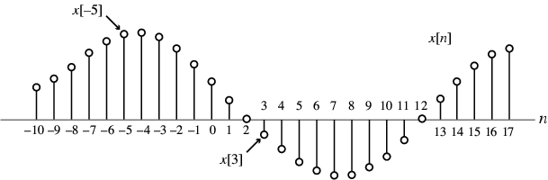
§2.1 Discrete-Time Signals:
Time-Domain Representation
Graphical representation of a discrete-time signal with real-valued samples is as shown below:

Slide 6
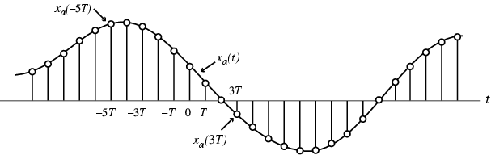
§2.1 Discrete-Time Signals:
Time-Domain Representation
In some applications, a discrete-time sequence {x[n]} may be generated by periodically sampling a continuous-time signal x_{a}(t) at uniform intervals of time

Slide 7
§2.1 Discrete-Time Signals:
Time-Domain Representation
Two types of discrete-time signals:
- Sampled-data signals in which samples are continuous-valued
- Digital signals in which samples are discrete-valued
Signals in a practical digital signal processing system are digital signals obtained by quantizing the sample values either by rounding or truncation

Slide 8
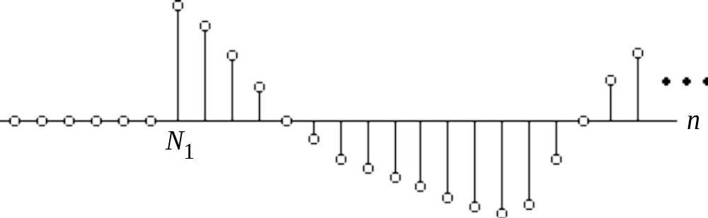
§2.1 Discrete-Time Signals:
Time-Domain Representation
A right-sided sequence x[n] has zero-valued samples for n < N₁
A right-sided sequence
If N₁≥ 0, a right-sided sequence is called a causal sequence

Slide 9
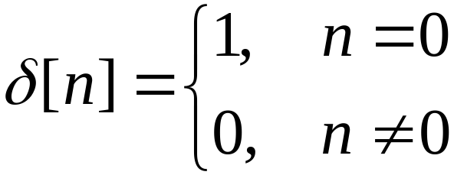
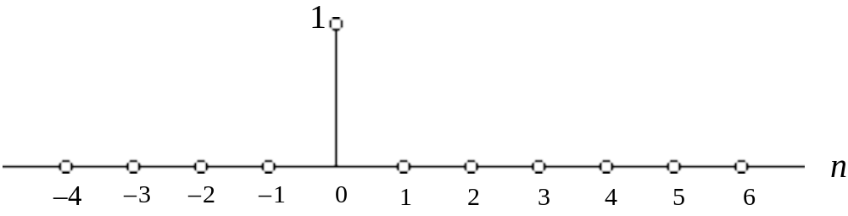
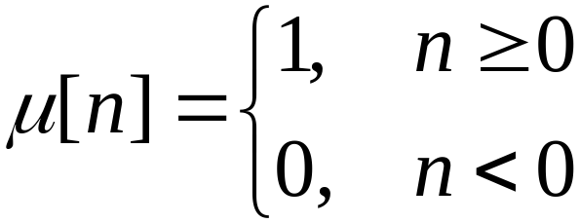
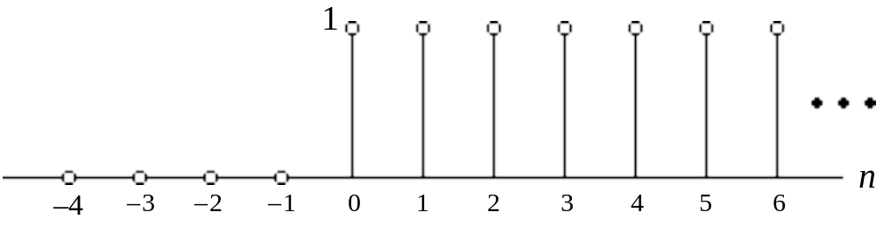
§2.2 Basic Sequences
Unit sample sequence -
Unit step sequence -

Slide 10
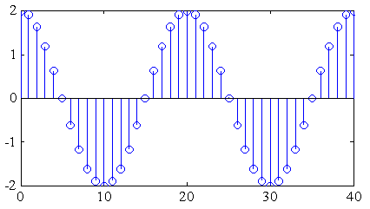
§2.2 Basic Sequences
Real sinusoidal sequence -
x[n]=Acos(ω₀n+ϕ)
where A is the amplitude, ω₀ is the angular frequency, and ϕ is the phase of x[n]
Example -

Slide 11
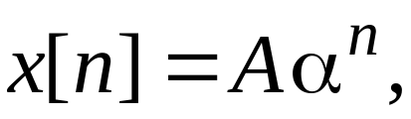

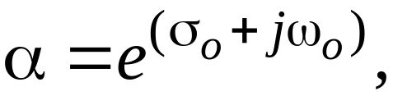
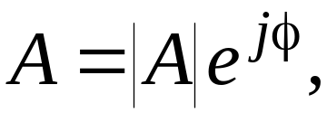
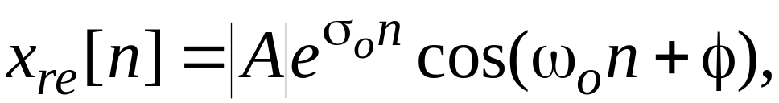
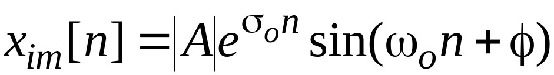
§2.2 Basic Sequences
Exponential sequence -
where A and α are real or complex numbers
If we write
then we can express
where

Slide 12
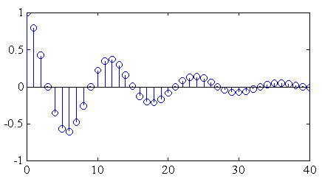
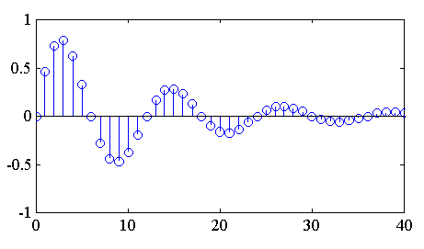
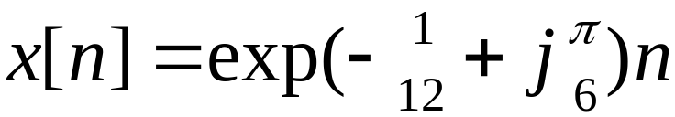
§2.2 Basic Sequences
x_{re}[n] and x_{im}[n] of a complex exponential sequence are real sinusoidal sequences with constant (σ₀=0), growing (σ₀>0) , and decaying (σ₀<0) amplitudes for n > 0
Real part
Imaginary part

Slide 13
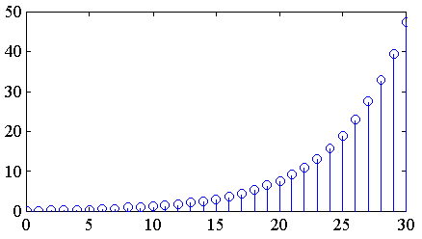
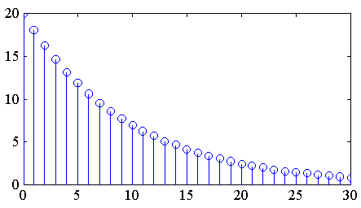
§2.2 Basic Sequences
Real exponential sequence -
x[n]=Aα^{n}, -∞< n < ∞
where A and α are real numbers
α=1.2
α=0.9

Slide 14
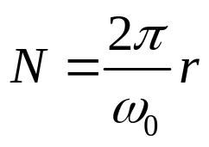
§2.2 Basic Sequences
Sinusoidal sequence Acos(ω₀n + ϕ) and complex exponential sequence Bexp(jω₀n) are periodic sequences of period N if ω₀N=2πr
where N and r are positive integers
Smallest value of N satisfying
is the fundamental period of the sequence
To verify the above fact, consider
x₁[n]= Acos(ω₀n + ϕ)
x₂[n]= Acos(ω₀ ( n+N) + ϕ)

Slide 15
§2.2 Basic Sequences
Now
x₂[n]= cos(ω₀ ( n+N) + ϕ)
= cos(ω₀n+ϕ)cosω₀N - sin(ω₀n+ϕ)sinω₀N
which will be equal to cos(ω₀n+ϕ)=x₁[n] only if sinω₀N= 0 and cosω₀N = 1
These two conditions are met if and only if ω₀N= 2πr or 2π/ω₀ = N/r

Slide 16
§2.2 Basic Sequences
If 2π/ω₀ is a noninteger rational number, then the period will be a multiple of 2π/ω₀
Otherwise, the sequence is aperiodic
Example - x[n]=sin(√3n+ϕ) is an aperiodic sequence

Slide 17
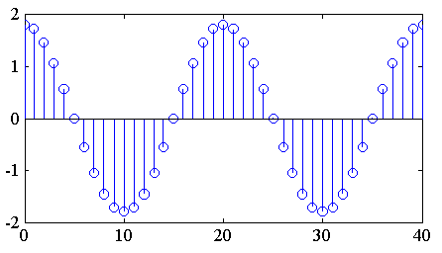
§2.2 Basic Sequences
ω₀ = 0.1π
Here ω₀ = 0.1π
Hence N= 2πr/ω₀ = 20 for r = 1

Slide 18
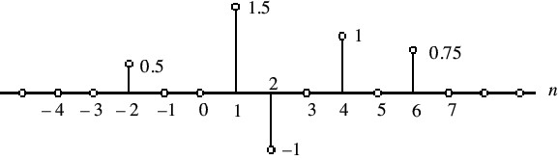

§2.3 Discrete Signal Decomposition
An arbitrary sequence can be represented in the time-domain as a weighted sum of some basic sequence and its delayed (advanced) versions

Slide 19
§2.4 Sampling of
Continuous-time Signals
Often, a discrete-time sequence x[n] is developed by uniformly sampling a continuous-time signal g_{a}(t) as indicated below
The relation between the two signals is
g[n]=g_{a}(t)|_{t=nT}=g_{a}(nT), n=…, -2, -1, 0, 1, 2, …

Slide 20
§ 2.4 Sampling of
Continuous-time Signals
g[n]=ga(t)|t=nT=ga(nT), n=…, -2, -1, 0, 1, 2, …
T : sampling period
F_{T} :sampling frequency,
i.e., F_{T} =1/T
Question:
wether g(n) can include all information of g_{a}(t) ,
i.e. can we recove the ga(t) from g(n)?

Slide 21
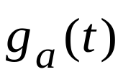
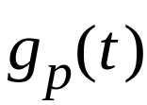


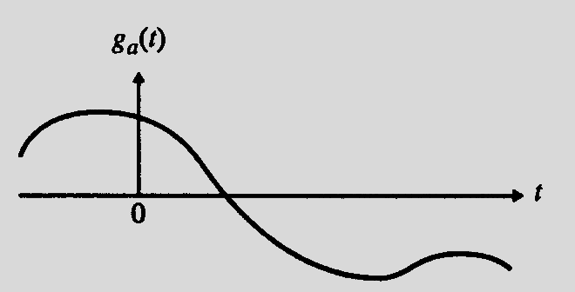
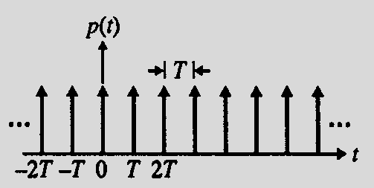
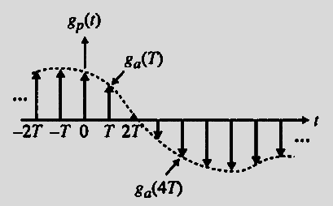
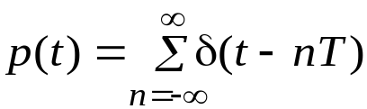
§ 2.4.1 Effect of Sampling in the
Frequency Domain
To establish the relation between the spectrum of g_{a}(t) and g[n] , we treat the sampling operation mathematically as a multiplication of g_{a}(t) by a periodic impulse train p(t):

Slide 22
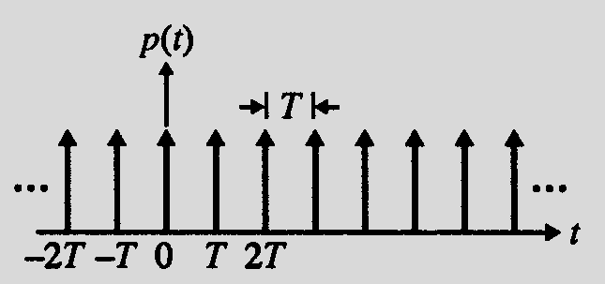
§ 2.4.1 Effect of Sampling in the
Frequency Domain
p(t) consists of a train of ideal impulses with a period T as shown below
Called : ideal impulse sampling

Slide 23
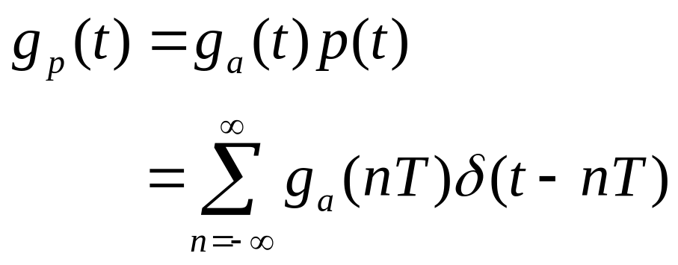
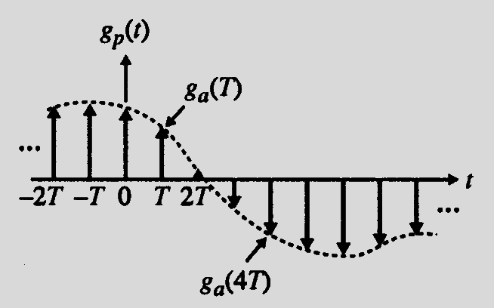
§ 2.4.1 Effect of Sampling in the
Frequency Domain
The multiplication
operation yields an
impulse train:

Slide 24
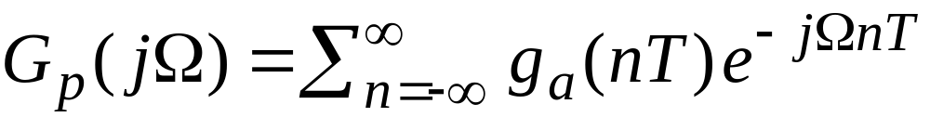
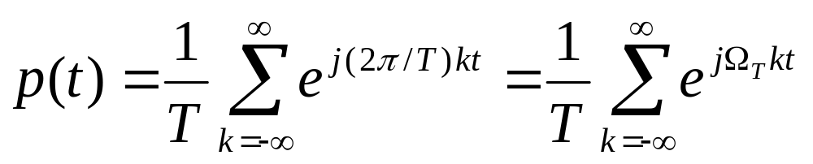

§ 2.4.1 Effect of Sampling in the
Frequency Domain
There are two different forms of G_{p}(jΩ) :
One form is given by the weighted sum of the CTFTs of δ(t-nT):
the second form: we note that p(t) can be expressed as a Fourier series:
where

Slide 25
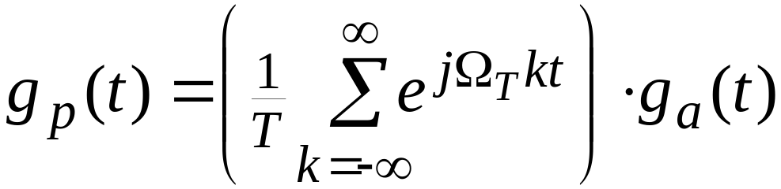
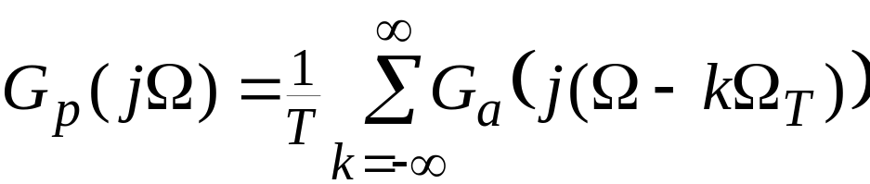
§ 2.4.1 Effect of Sampling in the
Frequency Domain
The impulse train g_{p}(t) therefore can be expressed as
From the frequency-shifting property of the CTFT:

Slide 26
§ 2.4.1 Effect of Sampling in the
Frequency Domain
Conclusion:
G_{p}(jΩ) is a periodic function of Ω consisting of a sum of shifted and scaled replicas of G_{a}(jΩ) , shifted by integer multiples of Ω_{T} and scaled by 1/T

Slide 27
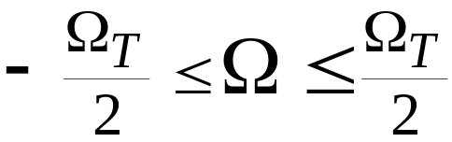
§ 2.4.1 Effect of Sampling in the
Frequency Domain
the previous equation for k = 0 is the baseband portion of G_{p}(jΩ) , and each of the remaining terms are the frequency translated portions of G_{p}(jΩ)
The frequency range
is called the baseband or Nyquist band

Slide 28
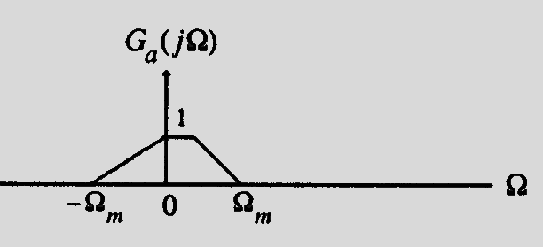
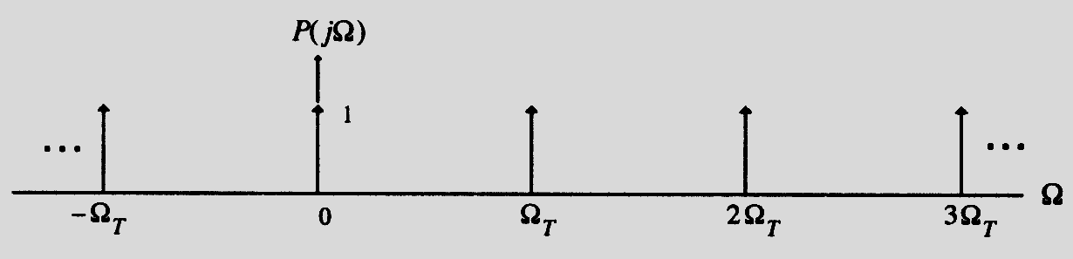
§ 2.4.1 Effect of Sampling in the
Frequency Domain
Assume g_{a}(t) is a band-limited signal with a CTFT G_{a}(jΩ) as shown below
The spectrum P(jΩ) of p(t) having a sampling period T=2π/Ω_{T} is indicated below

Slide 29
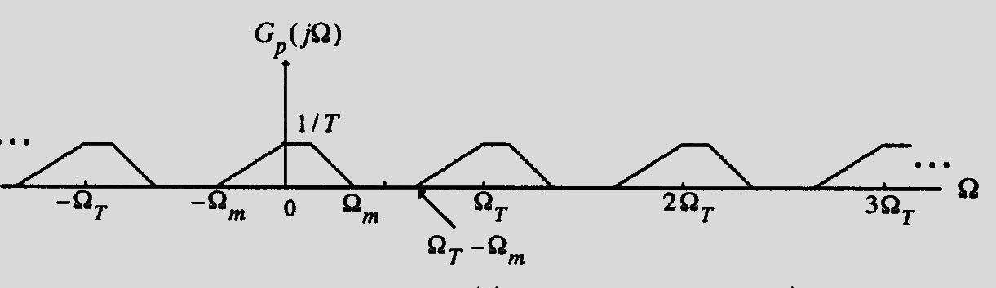
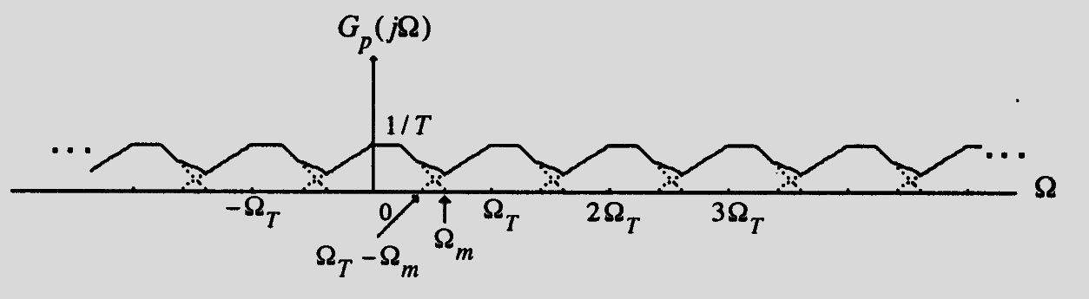
§ 2.4.1 Effect of Sampling in the
Frequency Domain
Two possible spectra of G_{p}(jΩ) are shown below
spectra aliasing phenomenon

Slide 30
§ 2.4.1 Effect of Sampling in the
Frequency Domain
It is evident from the top figure on the previous slide that if Ω_{T}>2 Ω_{m} , there is no overlap between the shifted replicas of G_{a}(jΩ) generating G_{p}(jΩ)
On the other hand, as indicated by the figure on the bottom, if Ω_{T}<2 Ω_{m} , there is an overlap of the spectra of the shifted replicas of G_{a}(jΩ) generating G_{p}(jΩ)----called spectra aliasing phenomenon

Slide 31
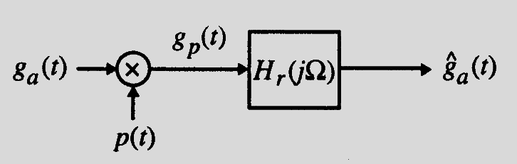
§2.4.1 Reconstruction of Sampled
Signal
If Ω_{T}>2 Ω_{m} , g_{a}(t) can be recovered exactly from g_{p}(t) by passing it through an ideal lowpass filter H_{r}(jΩ) with a gain T and a cutoff frequency Ω_{c} greater than Ω_{m} and less than Ω_{T} - Ω_{m} as shown below

Slide 32
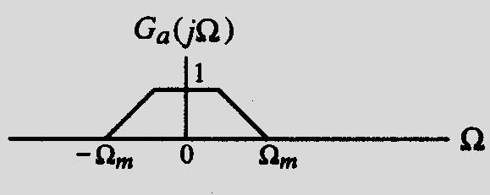
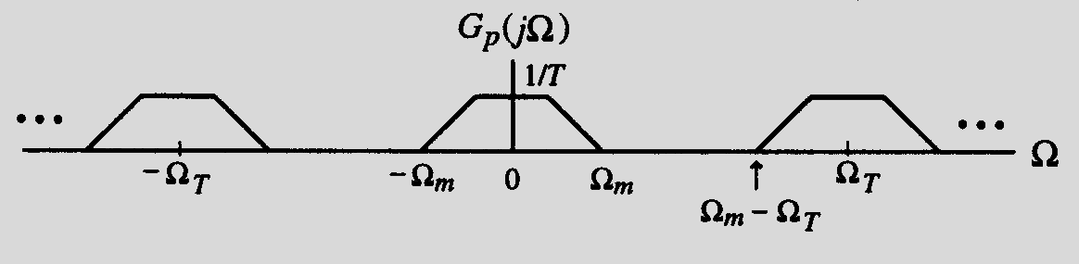
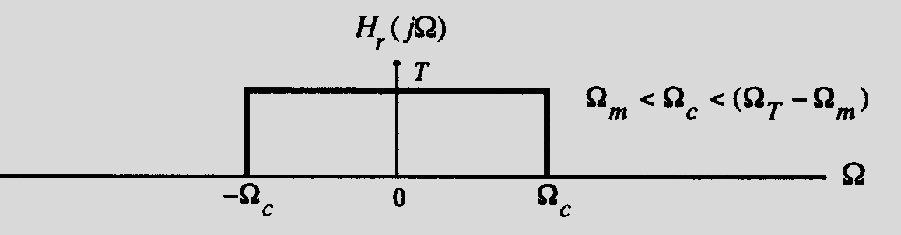

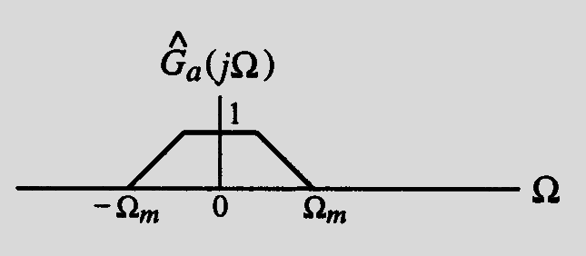
§2.4.1 Reconstruction of Analog
Signal
The spectra of the filter and pertinent signals are shown below

Slide 33

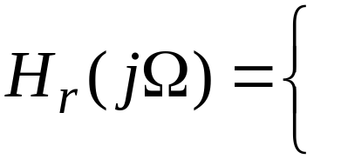
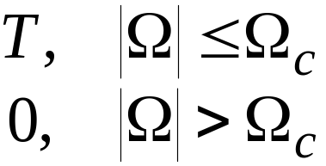
§2.4.1 Reconstruction of Analog
Signal
We now derive the expression for the output
of the ideal lowpass reconstruction filter
H_{r}(jΩ) as a function of the samples g[n]
The impulse response h_{r}(t) of the lowpass reconstruction filter is obtained by taking the inverse FT of H_{r}(jΩ)

Slide 34
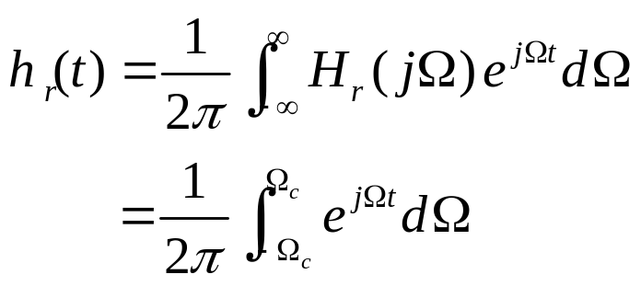
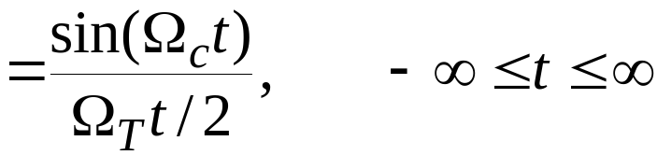
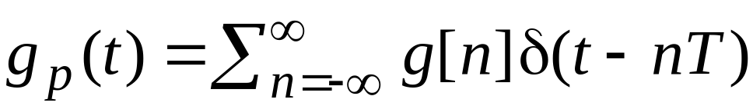
§2.4.1 Reconstruction of Analog
Signal
Thus, the impulse response is given by
The input to the lowpass filter is the impulse train g_{p}(t):

Slide 35

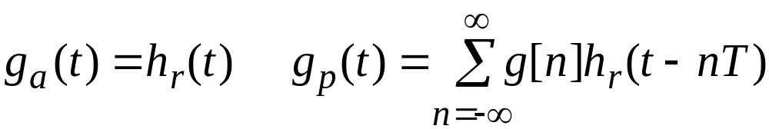

§ 2.4.1 Recovery of the Analog Signal
Therefore, the output of the ideal lowpass filter is given by:
^
^
*
Substituting h_{r}(t)=sin(Ω_{c}t)/(Ω_{T}t/2) in the above and assuming for simplicity
Ω_{c}= Ω_{T}/2= π/T , we get
Interpolation function
^

Slide 36

§ 2.4.1 Recovery of the Analog Signal
The ideal bandlimited interpolation process is illustrated below

Slide 37
§2.4.1 Reconstruction of Sampled
Signal
if Ω_{T}< 2 Ω_{m} , due to the overlap of the shifted replicas of G_{a}(jΩ) , the spectrum G_{p}(jΩ) cannot be separated by filtering to recover G_{a}(jΩ) because of the distortion caused by a part of the replicas immediately outside the baseband folded back or aliased into the baseband

Slide 38
§2.4.2 Sampling Theorem
Sampling theorem:
- Let g_{a}(t) be a band-limited signal with CTFT
G_{a}(jΩ)=0 , for | Ω|> Ω_{m}
- if Ω_{T} ≥ 2 Ω_{m，}g_{a}(t) is uniquely determined by its samples g_{a}(nT) , -∞≤n≤∞ ,where Ω_{T}=2π/T
- The condition Ω_{T} ≥ 2 Ω_{m} is often referred to as the Nyquist condition
- The frequency Ω_{T}/2 is usually referred to as the folding frequency

Slide 39
§2.4.2 Sampling Theorem
The highest frequency Ω_{m} contained in g_{a}(t) is usually called the Nyquist frequency since it determines the minimum sampling frequency Ω_{T} =2Ω_{m} that must be used to fully recover g_{a}(t) from its sampled version
The frequency 2Ω_{m} is called the Nyquist rate

Slide 40

§2.4.2 Sampling Theorem
Oversampling - The sampling frequency is higher than the Nyquist rate
Undersampling - The sampling frequency is lower than the Nyquist rate
Critical sampling - The sampling frequency is equal to the Nyquist rate
Note: A pure sinusoid may not be recoverable from its critically sampled version
Example:

Slide 41
§2.4.3 examples of sampling theorem
In digital telephony, a 3.4 kHz signal bandwidth is acceptable for telephone conversation
Here, a sampling rate of 8 kHz, which is greater than twice the signal bandwidth, is used

Slide 42
§2.4.4 examples of sampling theorem
In high-quality analog music signal processing, a bandwidth of 20 kHz has been determined to preserve the fidelity
Hence, in compact disc (CD) music systems, a sampling rate of 44.1 kHz, which is slightly higher than twice the signal bandwidth, is used

Slide 43



§2.4.4 examples of sampling theorem
Example - Consider the three continuous-time sinusoidal signals:
frequency: 3 Hz,
frequency: 7 Hz,
frequency: 13 Hz,
Their corresponding CTFTs are:

Slide 44







§2.4.4 examples of sampling theorem
Sampling rate T = 0.1 sec, f=10hz
Three sampling signal: g_{1p}(t), g_{2p}(t) , and g_{3p}(t)
Sequence Representation:

Slide 45

§2.4 The Sampling Process
Plots of these sequences (shown with circles) and their parent time functions are shown below:
Note that each sequence has exactly the same sample value for any given n

Slide 46


§2.4.4 examples of sampling theorem
Their corresponding CTFTs are given by

Slide 47



§2.4.4 examples of sampling theorem
These three transforms are plotted below

Slide 48



§2.4.4 examples of sampling theorem
Plots of the 3 sampled signals’ CTFTs are:
FT
g_{1p}(t)
FT
g_{2p}(t)
FT
g_{3p}(t)

Slide 49
§2.4.4 examples of sampling theorem
These figures also indicate by dotted lines the frequency response of an ideal lowpass filter with a cutoff at Ω_{c}=Ω_{T}/2=10π and a gain T=0.1
The CTFTs of the lowpass filter output are also shown in these three figures
In the case of g₁(t), the sampling rate satisfies the Nyquist condition, hence no aliasing

Slide 50
§2.4.4 examples of sampling theorem
Moreover, the reconstructed output is precisely the original continuous-time signal
In the other two cases, the sampling rate does not satisfy the Nyquist condition, resulting in aliasing and the filter outputs are all equal to cos(6πt)

Slide 51

§2.4.4 examples of sampling theorem
Consider again the three continuous-time signals: g₁(t)=cos(6πt), g₂(t)=cos(14πt) , and g₃(t)=cos(26πt)
The plot of the CTFT G_{1p}(jΩ) of the sampled version g_{1p}(t) of g₁(t) is shown below

Slide 52
§2.4.4 examples of sampling theorem
From the plot, it is apparent that we can recover any of its frequency-translated versions cos[(20k±6)πt] outside the baseband by passing g_{1p}(t) through an ideal analog bandpass filter with a passband centered at Ω = (20k±6)π

Slide 53


§2.4.4 examples of sampling theorem
For example, to recover the signal cos(34πt), it will be necessary to employ a bandpass filter with a frequency response
where Δ is a small number

Slide 54

§2.4.4 examples of sampling theorem
Likewise, we can recover the aliased baseband component cos(6πt) from the sampled version of either g_{2p}(t) or g_{3p}(t) by passing it through an ideal lowpass filter with a frequency response

Slide 55
§2.4.4 examples of sampling theorem
There is no aliasing distortion unless the original continuous-time signal also contains the component cos(6πt)
Similarly, from either g_{2p}(t) or g_{3p}(t) we can recover any one of the frequency-translated versions, including the parent continuous-time signal g₂(t) or g₃(t) as the case may be, by employing suitable filters

Slide 56
§2.4.4 examples of sampling theorem
This fact can also be verified by observing that
As a result, all three sequences are identical and it is difficult to associate a unique continuous-time function with each of these sequences

Slide 57




Rectangular impulse sampling
In real application, rectangular impulse- train is used to instead the impulse-train

Slide 58

Rectangular impulse sampling

Slide 59





